Slide 1

Creating Visualizations Using AWS S3 and AWS QuickSight
Dive into the world of data visualization with AWS S3 and AWS QuickSight! This presentation will guide you through using these powerful tools to create insightful and engaging visuals from your data.

Slide 2
AWS S3: Storing and Accessing Data
Amazon Simple Storage Service (S3) is a secure and scalable object storage service that provides a cost-effective way to store data. You can access data from your S3 buckets directly within AWS QuickSight.
Scalability
Durability
Security
S3 is designed for massive data storage, offering virtually unlimited storage capacity. You can store terabytes or even petabytes of data with ease.
S3 offers a high level of durability, ensuring your data is safe and protected from failures. Your data is replicated across multiple availability zones for redundancy.
S3 implements robust security measures, including encryption and access control mechanisms, to safeguard your data and meet compliance requirements.
PAGE : 2

Slide 3
AWS S3: Storing and Accessing Data
AWS S3 is a highly scalable and secure cloud storage service. Use S3 buckets to store your data, whether it's raw data files, CSV spreadsheets, or structured databases. The data is accessible from anywhere in the world.
Key Features
Use Cases
Benefits
Object-based storage
Data warehousing
Cost-effectiveness
High availability and durability
Backup and recovery
Scalability and flexibility
Flexible access control
Web content hosting
Increased security
PAGE : 3

Slide 4
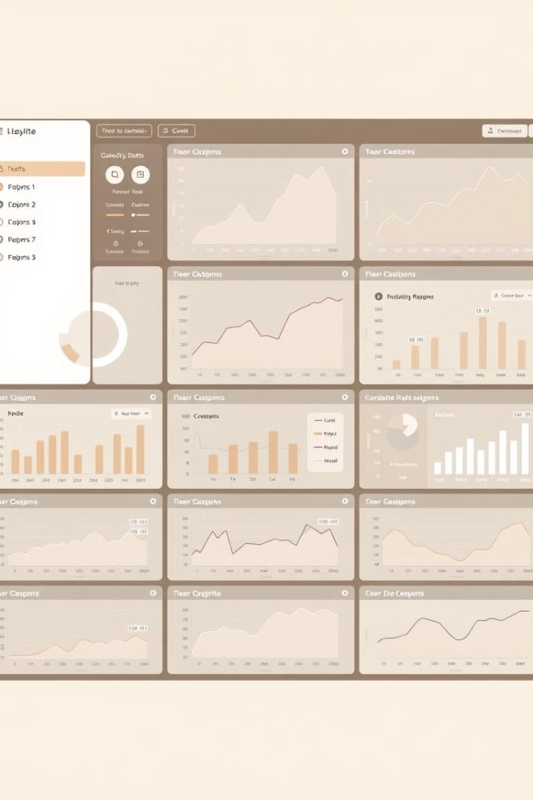
AWS QuickSight: A Business Intelligence Service
AWS QuickSight is a cloud-based business intelligence service that allows you to easily analyze and visualize data stored in various sources, including S3.
1
Interactive Dashboards
2
Data Exploration
QuickSight empowers you to create interactive dashboards with customizable visualizations, making it easy to explore data and gain insights.
With QuickSight's intuitive data exploration features, you can filter, sort, and drill down into your data to identify patterns and trends.
3
Collaboration
4
Data Storytelling
QuickSight enables collaborative data analysis, allowing you to share your visualizations and insights with colleagues and stakeholders.
Use QuickSight to create compelling data stories that effectively communicate insights and drive decision-making.
PAGE : 4

Slide 5





Connecting AWS S3 to AWS QuickSight
Connecting your S3 bucket to AWS QuickSight allows you to access your data directly within the QuickSight environment, making data analysis and visualization a seamless process.
Create a Dataset
Connect to S3
Configure Connection
Preview Data
Begin by creating a dataset in QuickSight to represent your data from S3.
Specify your S3 bucket name and the data files you want to access.
Configure the connection settings, including access credentials and data format.
Review the imported data to ensure it is correctly structured and ready for analysis.
PAGE : 5

Slide 6
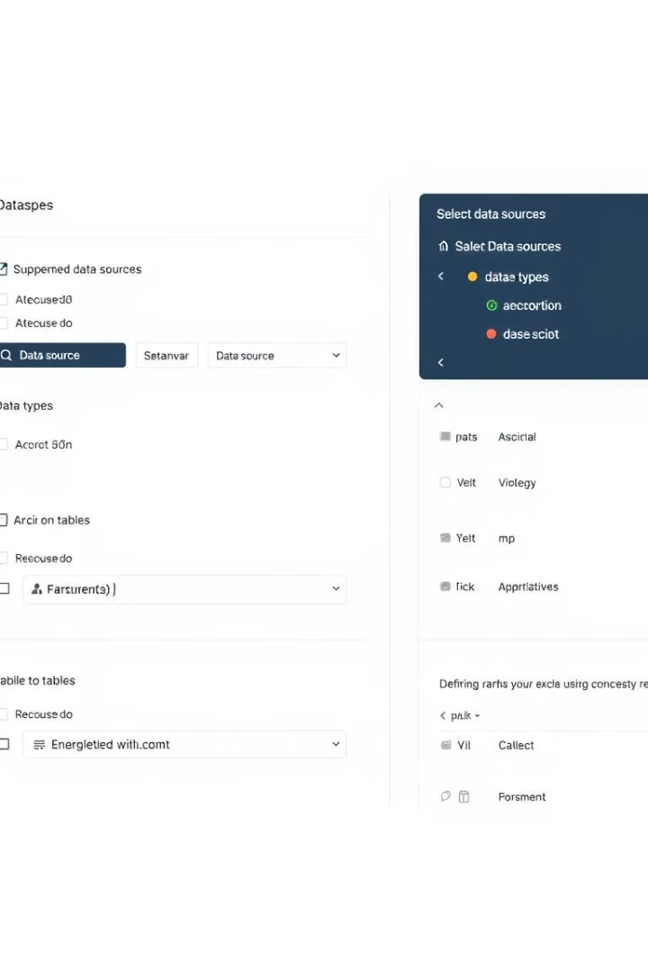
Creating Datasets in AWS QuickSight
Datasets in AWS QuickSight provide a structured representation of your data, enabling you to analyze and visualize it effectively.
Data Sources
Choose your data source, whether it's a S3 bucket, a database, or other supported sources.
Data Preparation
Cleanse and prepare your data for analysis by transforming, filtering, and merging data from multiple sources.
Data Relationships
Define relationships between different tables in your dataset to enable cross-table analysis and visualizations.
PAGE : 6

Slide 7
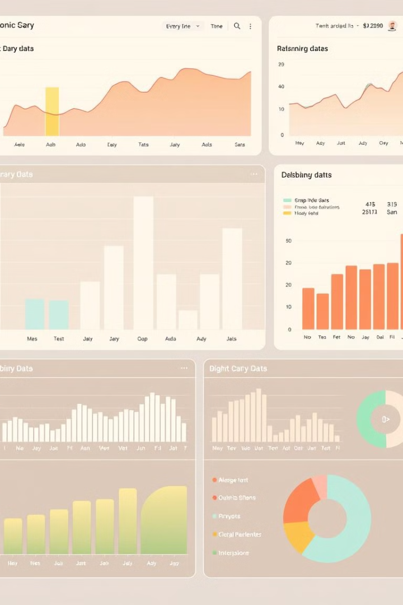




Designing Visualizations in AWS QuickSight
QuickSight offers a wide variety of visualization types to help you effectively communicate data insights and tell compelling stories.
Bar Charts
Line Graphs
Ideal for comparing categorical data across different categories or time periods.
Suitable for visualizing trends and patterns over time.
Pie Charts
Scatter Plots
Useful for showing parts of a whole or proportions.
Effective for visualizing relationships between two numerical variables.
PAGE : 7

Slide 8

Customizing Visualizations
QuickSight provides a comprehensive set of customization options to tailor your visualizations to meet your specific needs and preferences.
Colors and Themes
1
Choose from a range of color palettes and themes to create visually appealing and branded visualizations.
2
Labels and Titles
Add clear labels and titles to provide context and enhance the readability of your visualizations.
Chart Styles
3
Customize the appearance of your charts with options for different chart types, styles, and visual effects.
4
Interactive Elements
Enhance user engagement by adding interactive elements, such as tooltips, drill-downs, and filters.
PAGE : 8

Slide 9

Sharing and Collaborating on Visualizations
QuickSight enables seamless sharing and collaboration on visualizations, allowing you to share your insights and work together with others.
Share Dashboards
Collaboration Features
Share your dashboards with colleagues and stakeholders, providing them with access to your data and insights.
Collaborate on dashboards in real-time using QuickSight's built-in collaboration features, including commenting and annotations.
Data Governance
QuickSight provides data governance features to ensure data security and control access to visualizations.
PAGE : 9

Slide 10
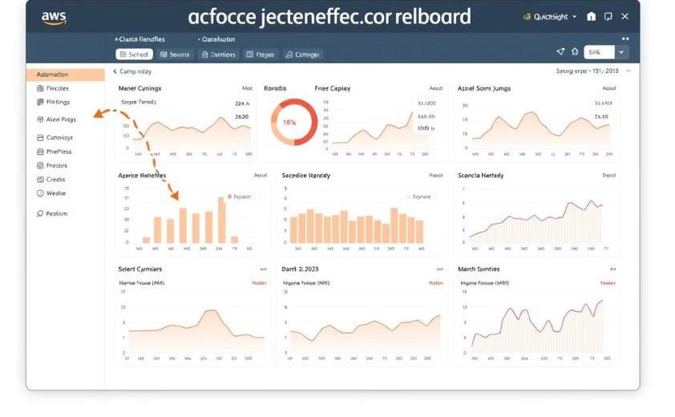
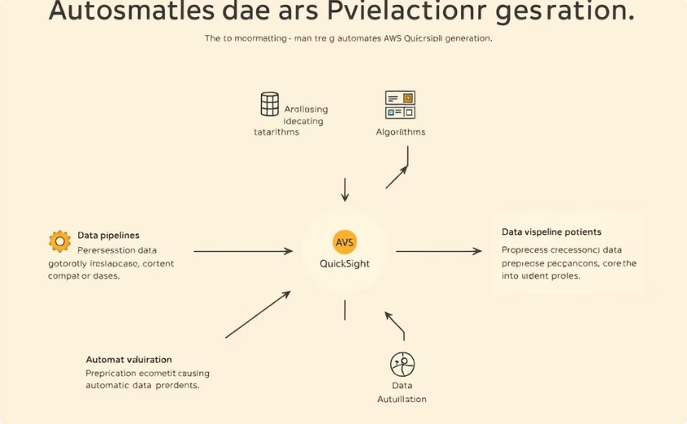
Automating Visualization Generation
AWS QuickSight offers features to automate the generation of visualizations, saving time and streamlining your data analysis workflow.
Scheduled Refresh
Data Pipelines
Automate visualization updates based on a defined schedule to keep your dashboards up-to-date with the latest data.
Integrate data pipelines to seamlessly update your datasets and visualizations based on data changes.
PAGE : 10

Slide 11
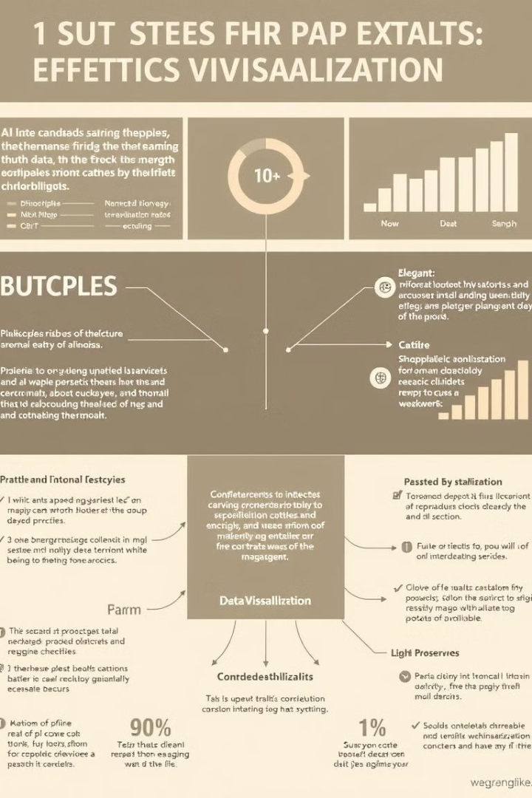
Best Practices and Troubleshooting
Follow best practices and be prepared to troubleshoot any challenges that might arise during your data visualization journey.
1
Data Quality
2
Visualization Selection
Ensure data quality by cleaning and preparing your data before creating visualizations.
Choose the right visualization type based on your data and the message you want to convey.
3
Accessibility
4
Troubleshooting
Design visualizations that are accessible to all users, regardless of their abilities.
Utilize QuickSight's troubleshooting tools and documentation to address any issues.
PAGE : 11

Slide 12

Conclusion and Next Steps
AWS S3 and AWS QuickSight provide a powerful combination for creating and sharing impactful data visualizations. Explore the full potential of these services to gain deeper insights and make data-driven decisions.
PAGE : 12

